Slide 1

Refactoring
HelloWorld Application
SSE USTC Qing Ding
dingqing@ustc.edu.cn

Slide 2
Theme of this Presentation
How a simple HelloWorld application can be refactored in order to achieve the agility (and testability)?
  How can I change a certain part of an application without affecting other parts of the code?
  How can I wire different parts of the application without writing a lot of glue code myself?
  How can I test the business logic without being tied up with a particular framework?

Slide 3
Refactoring HelloWorld Application
1.HelloWorld
2.HelloWorld with command line arguments
3.HelloWorld with decoupling without using Interface
4.HelloWorld with decoupling using Interface
5.HelloWorld with decoupling through Factory
6.HelloWorld using Spring framework as a factory class but not using DI (Dependency Injection)
7.HelloWorld using Spring framework's DI
8.HelloWorld using Spring framework's DI and XML configuration file
9.HelloWorld using Spring framework's DI and XML configuration file with constructor argument

Slide 4
1. HelloWorld Application

Slide 5
HelloWorld
// This is a good old HelloWorld application we all have written
// the first time we learn Java programming.
public class HelloWorld {
public static void main(String[] args) {
System.out.println("Hello World!");
}
}

Slide 6
HelloWorld: Outstanding Problems
This code is not extensible. You have change code (and recompile) to handle a situation below.
  What if I want to change the message?

Slide 7
HelloWorld: Areas for Refactoring
Support a simple and flexible mechanism for changing the message

Slide 8
2. HelloWorld Application with Command Line Arguments

Slide 9
HelloWorld With Command Line arguments
public class HelloWorldWithCommandLine {
public static void main(String[] args) {
if(args.length > 0) {
System.out.println(args[0]);
} else {
System.out.println("Hello World!");
}
}
}

Slide 10
HelloWorld With Command Line arguments: Areas Refactored
This code externalize the message content and read it in at runtime, from the command line argument
  You can change the message without changing and recompiling the code

Slide 11
HelloWorld With Command Line arguments: Outstanding Problems
The code responsible for the rendering message (renderer – the code that does println) is also responsible for obtaining the message
  Changing how the message is obtained means changing the code in the renderer
The renderer cannot be changed easily
  What if I want to output the message differently, maybe to stderr instead of stdout, or enclosed in HTML tags rather than as plain text?

Slide 12
HelloWorld With Command Line arguments: Areas for Further Refactoring
Rendering logic should be in a logically separate code from the rest of the code
Message provider logic should be in a logically separate code from the rest of the code

Slide 13
3. HelloWorld Application with Decoupling (without using Interface)

Slide 14
HelloWorld With Decoupling
De-couple message provider logic implementation from the rest of the code by creating a separate class
public class HelloWorldMessageProvider {
public String getMessage() {
return "Hello World!";
}
}

Slide 15
HelloWorld With Decoupling
De-couple message rendering logic implementation from the rest of the code
Message rendering logic is given HelloWorldMessageProvider object by someone (code is in the next slide) – this is Dependency Injection behavior
public class StandardOutMessageRenderer {
private HelloWorldMessageProvider messageProvider = null;
public void render() {
if (messageProvider == null) {
throw new RuntimeException("You must set the property messageProvider of class:“ + StandardOutMessageRenderer.class.getName());
}
System.out.println(messageProvider.getMessage());
}
// continued

Slide 16
HelloWorld With Decoupling
// continued from previous page
public void setMessageProvider(HelloWorldMessageProvider provider) {
this.messageProvider = provider;
}
public HelloWorldMessageProvider getMessageProvider() {
return this.messageProvider;
}
}

Slide 17
HelloWorld With Decoupling
Launcher
public class HelloWorldDecoupled {
public static void main(String[] args) {
StandardOutMessageRenderer mr =
new StandardOutMessageRenderer();
HelloWorldMessageProvider mp =
new HelloWorldMessageProvider();
mr.setMessageProvider(mp);
mr.render();
}
}

Slide 18
HelloWorld With Decoupling: Areas Refactored
Message provider logic and message renderer logic are separated from the rest of the code

Slide 19
HelloWorld With Decoupling: Outstanding Problems
A particular MessageRenderer implementation (StandardOutMessageRenderer) and a particular MessageProvider implementation (HelloWorldMessageProvider) are hard-coded in the main code

Slide 20
HelloWorld With Decoupling: Areas for Further Refactoring
Let these components implement interfaces and the launcher use these interfaces

Slide 21
4. HelloWorld Application with Decoupling Using Interface

Slide 22
HelloWorld With Decoupling (Using Interface)
Message provider logic now uses Java interface
public interface MessageProvider {
public String getMessage();
}
public class HelloWorldMessageProvider
implements MessageProvider {
public String getMessage() {
return "Hello World!";
}
}

Slide 23
HelloWorld With Decoupling (using Interface)
Message renderer logic now uses Java interface
Message rendering logic is given MessageProvider object by someone – this is Dependency Injection behavior
public interface MessageRenderer {
public void render();
public void setMessageProvider(MessageProvider provider);
public MessageProvider getMessageProvider();
}

Slide 24
HelloWorld With Decoupling (using Interface)
public class StandardOutMessageRenderer implements MessageRenderer {
// MessageProvider is Java Interface
private MessageProvider messageProvider = null;
public void render() {
if (messageProvider == null) {
throw new RuntimeException("You must set the property messageProvider of class:“ + StandardOutMessageRenderer.class.getName());
}
System.out.println(messageProvider.getMessage());
}
// Continued to the next page

Slide 25
HelloWorld With Decoupling
Decouple message rendering logic
public void setMessageProvider(MessageProvider provider) {
this.messageProvider = provider;
}
public MessageProvider getMessageProvider() {
return this.messageProvider;
}
}

Slide 26
HelloWorld With Decoupling (using Interface)
Launcher
public class HelloWorldDecoupled {
public static void main(String[] args) {
MessageRenderer mr = new StandardOutMessageRenderer();
MessageProvider mp = new HelloWorldMessageProvider();
mr.setMessageProvider(mp);
mr.render();
}
}

Slide 27
HelloWorld With Decoupling (using Interface): Areas Refactored
Message rendering logic can change without affecting messaging provider logic
Message provider logic can change without affecting message rendering logic

Slide 28
HelloWorld With Decoupling: Outstanding Problems
Using different implementation of either the MessageRenderer or MessageProvider interfaces means a change to the business logic code (launcher in this example)

Slide 29
HelloWorld With Decoupling: Areas for Further Refactoring
Create a simple factory class that reads the implementation class names from a properties file and instantiate them during runtime on behalf of the application

Slide 30
5. HelloWorld Application with Decoupling through Factory class

Slide 31
HelloWorld With Factory Class
public class MessageSupportFactory {
private static MessageSupportFactory instance = null;
private Properties props = null;
private MessageRenderer renderer = null;
private MessageProvider provider = null;
private MessageSupportFactory() {
props = new Properties();
try {
props.load(new FileInputStream("msf.properties"));
// get the implementation classes
String rendererClass = props.getProperty("renderer.class");
String providerClass = props.getProperty("provider.class");
renderer = (MessageRenderer) Class.forName(rendererClass).newInstance();
provider = (MessageProvider) Class.forName(providerClass).newInstance();
} catch (Exception ex) {
ex.printStackTrace();
}
}

Slide 32
HelloWorld With Factory Class
static {
instance = new MessageSupportFactory();
}
public static MessageSupportFactory getInstance() {
return instance;
}
public MessageRenderer getMessageRenderer() {
return renderer;
}
public MessageProvider getMessageProvider() {
return provider;
}
}

Slide 33
HelloWorld With Factory Class
public class HelloWorldDecoupledWithFactory {
public static void main(String[] args) {
MessageRenderer mr = MessageSupportFactory.getInstance().getMessageRenderer();
MessageProvider mp = MessageSupportFactory.getInstance().getMessageProvider();
mr.setMessageProvider(mp);
mr.render();
}
}

Slide 34
HelloWorld With Factory Class: Properties file
# msf.properties
renderer.class=StandardOutMessageRenderer
provider.class=HelloWorldMessageProvider

Slide 35
HelloWorld With Decoupling: Areas Refactored
Message retrieval implementation and Message renderer implementation can be replaced simply by changing the properties file
  No change is required in the business logic code

Slide 36
HelloWorld With Factory: Outstanding Problems
You still have to write a lot of glue code yourself to assemble the application together
  You have to write MessageSupportFactory class
  You still have to inject an instance of MessageProvider into the implementation of MessageRenderer manually

Slide 37
HelloWorld With Factory: Areas for Further Refactoring
We can use Spring framework to handles the problems mentioned in previous slide
Replace MessageSupportFactory class with Spring framework's DefaultListableBeanFactory class
  You can think of DefaultListableBeanFactory class as a more generic version of MessageSupportFactory class

Slide 38
6. HelloWorld Application with Spring Framework (but not using DI feature yet)

Slide 39
HelloWorld With Spring Framework
public class HelloWorldSpring {
public static void main(String[] args) throws Exception {
// Get the bean factory - the code of getBeanFactory() is in the next slide
BeanFactory factory = getBeanFactory();
MessageRenderer mr = (MessageRenderer) factory.getBean("renderer");
MessageProvider mp = (MessageProvider) factory.getBean("provider");
mr.setMessageProvider(mp);
mr.render();
}
// Continued in the next page

Slide 40
HelloWorld With Spring Framework (No need to understand this code)
// You write your own getBeanFactory() method using Spring framework's
// DefaultListableBeanFactoryclass.
private static BeanFactory getBeanFactory() throws Exception {
// get the bean factory
DefaultListableBeanFactory factory = new DefaultListableBeanFactory();
// create a definition reader
PropertiesBeanDefinitionReader rdr = new PropertiesBeanDefinitionReader(factory);
// load the configuration options
Properties props = new Properties();
props.load(new FileInputStream("beans.properties"));
rdr.registerBeanDefinitions(props);
return factory;
}
}

Slide 41
HelloWorld With Spring Framework: Areas Refactored
Removed the need of your own glue code (MessageSupportFactory)
Gained a much more robust factory implementation with better error handling and fully de-coupled configuration mechanism

Slide 42
HelloWorld With Spring Framework: Outstanding Problems
The startup code must have knowledge of the MessageRenderer's dependencies and must obtain dependencies and pass them to the MessageRenderer
  Spring acts as no more than a sophisticated factory class creating and supplying instances of classes as needed in this case
You are providing your own getBeanFactory() method using low-level API's of Spring framework

Slide 43
HelloWorld With Spring Framework: Areas for Further Refactoring
Use Dependency Injection (DI) of the Spring Framework
  Glue the application together externally using the BeanFactory configuration

Slide 44
7. HelloWorld Application using Spring Framework & Dependency Injection (DI)

Slide 45
HelloWorld using Spring Framework's DI
#Message renderer
renderer.class=StandardOutMessageRenderer
# Ask Spring to assign provider bean to the MessageProvider property
# of the Message renderer bean (instead of you doing it manually)
renderer.messageProvider(ref)=provider
#Message provider
provider.class=HelloWorldMessageProvider

Slide 46
HelloWorld using Spring Framework's DI
public class HelloWorldSpringWithDI {
public static void main(String[] args) throws Exception {
// get the bean factory
BeanFactory factory = getBeanFactory();
MessageRenderer mr = (MessageRenderer) factory.getBean("renderer");
// Note that you don't have to manually inject message
// provider to message renderer anymore.
mr.render();
}
// Continued in the next page

Slide 47
HelloWorld using Spring Framework's DI
private static BeanFactory getBeanFactory() throws Exception {
// get the bean factory
DefaultListableBeanFactory factory = new DefaultListableBeanFactory();
// create a definition reader
PropertiesBeanDefinitionReader rdr = new PropertiesBeanDefinitionReader(factory);
// load the configuration options
Properties props = new Properties();
props.load(new FileInputStream("beans.properties"));
rdr.registerBeanDefinitions(props);
return factory;
}
}

Slide 48
HelloWorld using Spring Framework's DI: Areas Refactored
The main() method now just obtains the MessageRenderer bean and calls render()
  It does not have to obtain MessageProvider bean and set the MessageProvider property of the MessageRenderer bean itself.
  This “wiring” is performed through Spring framework's Dependency Injection.

Slide 49
A Few Things to Observe
Note that we did not have to make any changes to the classes that are being wired together
These classes have no reference to Spring framework whatsoever and completely oblivious to Spring framework's existence
  No need to implement Spring framework's interfaces
  No need to extend Spring framework's classes
These classes are genuine POJO's which can be tested without dependent on Spring framework

Slide 50
8. HelloWorld Application with Spring Framework & Dependency Injection (DI) using XML Configuration File

Slide 51
Spring DI with XML file
Dependencies of beans are specified in an XML file
  XML based bean configuration is more popular than properties file based configuration

Slide 52
Spring DI with XML Configuration File
<beans>
<bean id="renderer"
class="StandardOutMessageRenderer">
<property name="messageProvider">
<ref local="provider"/>
</property>
</bean>
<bean id="provider"
class="HelloWorldMessageProvider"/>
</beans>

Slide 53
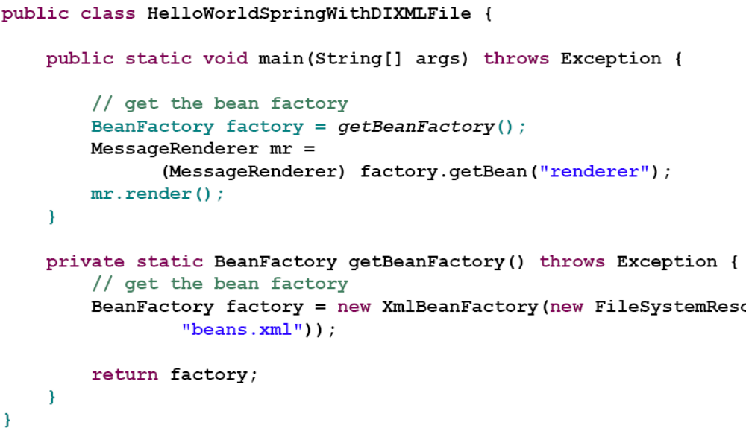
Spring DI with XML Configuration File

Slide 54
9. HelloWorld Application with Spring Framework & Dependency Injection (DI) using XML Configuration File with Constructor argument

Slide 55
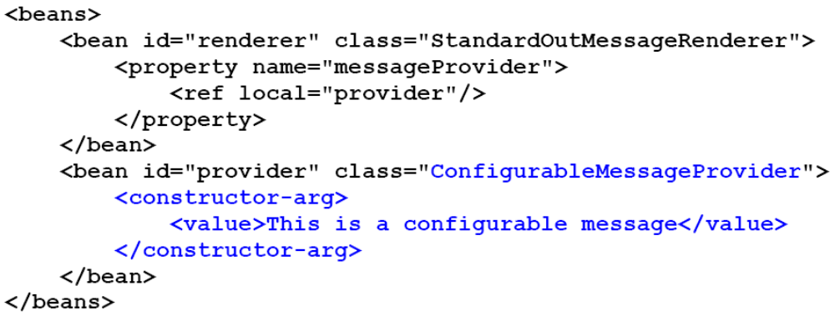
Spring DI with XML Configuration File: via Constructor

Slide 56
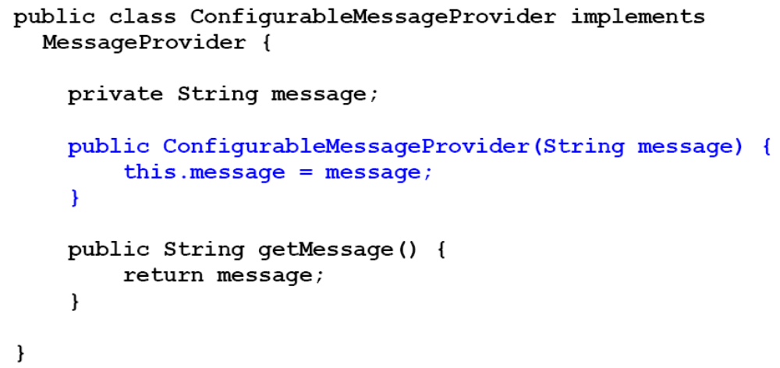
Spring DI with XML Configuration File: via Constructor

